Slide 2
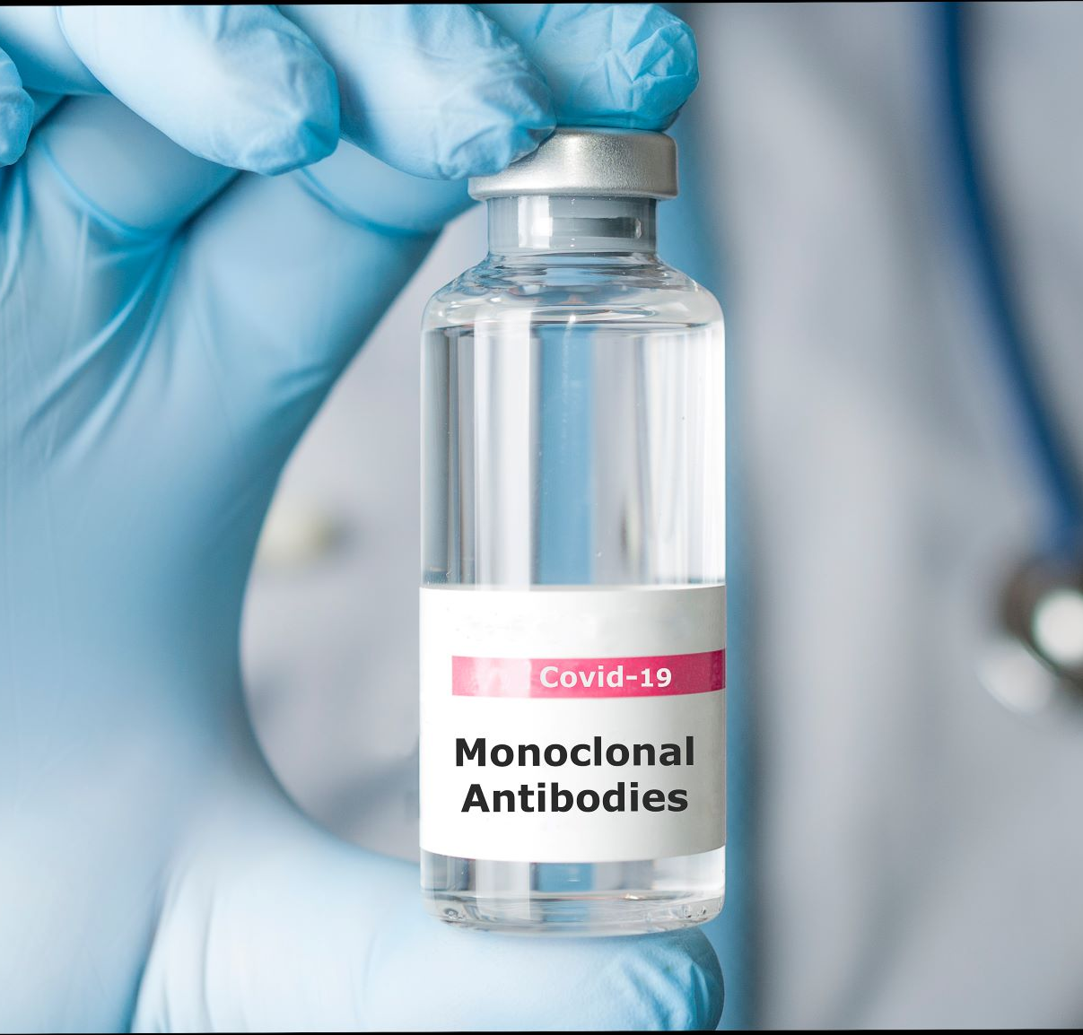

Slide 3
Monoclonal Antibodies Hispanic Education and Communication
Following is pro bono work by Lopez PR & Marketing Group
Background:
Life saving monoclonal antibodies were being underutilized, especially in the Hispanic markets
The reasons for underutilization is a lack of patient knowledge as well as a lack of referrals from primary doctors combined with a lack of communication by those doing COVID testing

Slide 4
Monoclonal Antibodies Hispanic Education and Communication
Strategies:
Communicate and educate Hispanic patients and family members that there is a treatment to help keep people out of Hospitals
Educate Hispanics about monoclonal antibodies treatment so if they come out COVID positive to quickly ask their doctors about the treatment
Objectives:
Increase substantially usage of monoclonal antibodies in the Hispanic community
Target Texas and California key cities with Hispanic COVID-19 patients

Slide 5
Monoclonal Antibodies Hispanic Education and Communication
Results:
Secured 2 minutes or more news stories in the following markets
El Paso- all stations (English and Spanish)
Houston – Univision & Telemundo
https://youtu.be/obwZic2AAEk and https://youtu.be/1LD8Jm06hsk
San Antonio – Univision
https://youtu.be/zqc0uOdV-F4
Los Angeles- Univision
https://youtu.be/I-jyXmvuAuo
Sacramento- Univision
San Diego- Univision (several new stories set up for April)
Successes so far:
El Paso major increase in usage
ABC- El Paso “more than 100 lives saved”
https://kvia.com/coronavirus/2021/01/23/antibody-infusion-treatment-saves-100-el-pasoans-from-virus-hospitalization

Slide 6
Monoclonal Antibodies Hispanic Education and Communication
Additional Tactics:
Lopez PR & Marketing Group developed a concept for a pilot Hispanic TV education plan along with local non-profits in Houston and San Diego
April 12- June 5th, 2021
Houston
Telemundo- 208 TV spots
Univision- 130 TV spots
1.5 million impressions
San Diego
Univision- 165 spots
Unimas- 90 spots
Azteca- 90 spots
1.0 million impressions

Slide 7
Monoclonal Antibodies Hispanic Education and Communication
Storyboard:

Slide 8
Monoclonal Antibodies Hispanic Education and Communication
YouTube Link to the TV Spots
Monoclonal Antibodies San Diego-Spanish
https://youtu.be/fgw36IQea-I
Monoclonal Antibodies Houston-Spanish
https://youtu.be/8pQorOm0eG0
Monoclonal Antibodies Generic-Spanish
https://youtu.be/-3xi4lrBdKc
Monoclonal Antibodies Generic-English
https://youtu.be/_nbZwfM2I5Q

